Slide 1
안드로이드 실무 4주차 과제
1901055 정시철

Slide 2
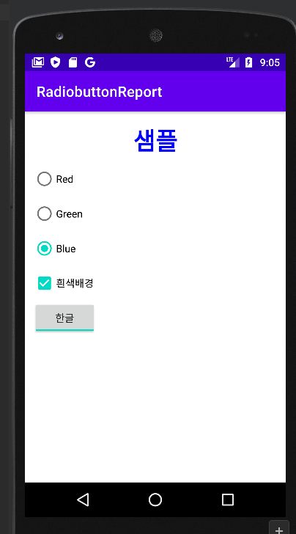
Report1 홀수 RadiobuttonReport
package com.example.report4_1; import androidx.appcompat.app.AppCompatActivity; import android.graphics.Color; import android.os.Bundle; import android.view.View; import android.widget.CheckBox; import android.widget.RadioButton; import android.widget.RadioGroup; import android.widget.TextView; import android.widget.ToggleButton; public class MainActivity extends AppCompatActivity { @Override protected void onCreate(Bundle savedInstanceState) { super.onCreate(savedInstanceState); setContentView(R.layout.activity_main); RadioGroup radioGroup = findViewById(R.id.radiogroup1); TextView textView = findViewById(R.id.text1); CheckBox checkBox = findViewById(R.id.checkbox1); ToggleButton toggle = findViewById(R.id.toggle1); radioGroup.setOnCheckedChangeListener(new RadioGroup.OnCheckedChangeListener() { @Override public void onCheckedChanged(RadioGroup radioGroup, int i) { switch (i){ case R.id.red: textView.setTextColor(Color.parseColor("#ff0000")); break; case R.id.green: textView.setTextColor(Color.parseColor("#00ff00")); break; case R.id.blue: textView.setTextColor(Color.parseColor("#0000ff")); break; } } }); checkBox.setOnClickListener(new View.OnClickListener() { @Override public void onClick(View view) { if (checkBox.isChecked()){ textView.setBackgroundColor(Color.parseColor("#ffffff")); } else { textView.setBackgroundColor(Color.parseColor("#ffff00")); } } }); toggle.setOnClickListener(new View.OnClickListener() { @Override public void onClick(View view) { if (toggle.isChecked()){ textView.setText("샘플"); } else{ textView.setText("Sample"); } } }); } }
<?xml version="1.0" encoding="utf-8"?> <LinearLayout xmlns:android="http://schemas.android.com/apk/res/android" xmlns:app="http://schemas.android.com/apk/res-auto" xmlns:tools="http://schemas.android.com/tools" android:layout_width="match_parent" android:layout_height="match_parent" android:orientation="vertical" android:padding="5pt" tools:context=".MainActivity"> <TextView android:id="@+id/text1" android:layout_width="match_parent" android:layout_height="wrap_content" android:padding="3pt" android:text="Sample" android:gravity="center" android:textStyle="bold" android:textSize="15pt" android:background="#ffff00" android:textColor="#ff0000" /> <RadioGroup android:id="@+id/radiogroup1" android:layout_width="match_parent" android:layout_height="wrap_content"> <RadioButton android:id="@+id/red" android:layout_width="wrap_content" android:layout_height="wrap_content" android:checked="true" android:text="Red"/> <RadioButton android:id="@+id/green" android:layout_width="wrap_content" android:layout_height="wrap_content" android:text="Green"/> <RadioButton android:id="@+id/blue" android:layout_width="wrap_content" android:layout_height="wrap_content" android:text="Blue"/> </RadioGroup> <CheckBox android:id="@+id/checkbox1" android:layout_width="wrap_content" android:layout_height="wrap_content" android:text="흰색배경" /> <ToggleButton android:id="@+id/toggle1" android:layout_width="wrap_content" android:layout_height="wrap_content" android:textOff="영문" android:textOn="한글" /> </LinearLayout>

Slide 3
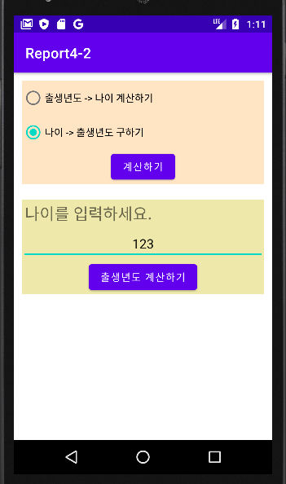
Report 2 홀수 나이, 출생년도 알아내기
package com.example.report4_2; import androidx.appcompat.app.AppCompatActivity; import android.graphics.Color; import android.os.Bundle; import android.text.Spannable; import android.text.SpannableString; import android.text.style.ForegroundColorSpan; import android.util.TypedValue; import android.view.View; import android.view.ViewGroup; import android.widget.Button; import android.widget.EditText; import android.widget.LinearLayout; import android.widget.RadioGroup; import android.widget.TextView; import android.widget.Toast; public class MainActivity extends AppCompatActivity { boolean type; @Override protected void onCreate(Bundle savedInstanceState) { super.onCreate(savedInstanceState); setContentView(R.layout.activity_main); RadioGroup radioGroup = findViewById(R.id.radiogroup); Button button1 = findViewById(R.id.button1); LinearLayout linearLayout = findViewById(R.id.linear); Button button2 = findViewById(R.id.button2); TextView textView = findViewById(R.id.text1); EditText editText = findViewById(R.id.editText); button1.setOnClickListener(new View.OnClickListener() { @Override public void onClick(View view) { switch (radioGroup.getCheckedRadioButtonId()){ case R.id.radio1: linearLayout.setBackgroundColor(Color.parseColor("#80FFD4")); textView.setText("태어난 년도를 입력하세요."); editText.setHint("태어난 년도를 입력하세요."); button2.setText("나이 계산하기"); linearLayout.setVisibility(View.VISIBLE); type = true; break; case R.id.radio2: linearLayout.setBackgroundColor(Color.parseColor("#EEE8AA")); textView.setText("나이를 입력하세요."); editText.setHint("나이를 입력하세요."); button2.setText("출생년도 계산하기"); linearLayout.setVisibility(View.VISIBLE); type = false; break; default: Toast.makeText(getBaseContext(),"항목을 선택해주세요.",Toast.LENGTH_SHORT).show(); } } }); button2.setOnClickListener(new View.OnClickListener() { @Override public void onClick(View view) { String tt = editText.getText().toString(); if (tt.equals("")){ Toast.makeText(getBaseContext(),"숫자를 입력해주세요.", Toast.LENGTH_SHORT).show(); } else { int input = Integer.parseInt(String.valueOf(editText.getText())); int output = 2023 - input; if (type == true&&input<2023&&input>1900){ String content = "당신의 나이는 "+output+"세 입니다."; SpannableString spannableString = new SpannableString(content); int start = content.indexOf(String.valueOf(output)); int end = start + String.valueOf(output).length(); SpannableString span = new SpannableString(content); span.setSpan(new ForegroundColorSpan(Color.YELLOW), start, end, Spannable.SPAN_EXCLUSIVE_EXCLUSIVE); Toast.makeText(MainActivity.this,span, Toast.LENGTH_LONG).show(); } else if(type == false &&input<130){ String content = "당신의 출생년도는 "+output+"년 입니다."; SpannableString spannableString = new SpannableString(content); int start = content.indexOf(String.valueOf(output)); int end = start + String.valueOf(output).length(); SpannableString span = new SpannableString(content); span.setSpan(new ForegroundColorSpan(Color.YELLOW), start, end, Spannable.SPAN_EXCLUSIVE_EXCLUSIVE); Toast.makeText(MainActivity.this,span, Toast.LENGTH_LONG).show(); } else if (type == true){ Toast.makeText(getBaseContext(), "출생년도를 정확히 입력해주세요.", Toast.LENGTH_SHORT).show(); } else{ Toast.makeText(getBaseContext(), "나이를 정확히 입력해주세요.", Toast.LENGTH_SHORT).show(); } } } }); } }
<?xml version="1.0" encoding="utf-8"?> <LinearLayout xmlns:android="http://schemas.android.com/apk/res/android" xmlns:app="http://schemas.android.com/apk/res-auto" xmlns:tools="http://schemas.android.com/tools" android:layout_width="match_parent" android:layout_height="match_parent" android:orientation="vertical" tools:context=".MainActivity"> <RadioGroup android:layout_margin="5pt" android:id="@+id/radiogroup" android:layout_width="match_parent" android:layout_height="wrap_content" android:background="#FFE5C4"> <RadioButton android:id="@+id/radio1" android:layout_width="wrap_content" android:layout_height="wrap_content" android:text="출생년도 -> 나이 계산하기"/> <RadioButton android:id="@+id/radio2" android:layout_width="wrap_content" android:layout_height="wrap_content" android:text="나이 -> 출생년도 구하기"/> <LinearLayout android:layout_width="match_parent" android:layout_height="wrap_content" android:orientation="horizontal" android:gravity="center"> <Button android:id="@+id/button1" android:layout_width="wrap_content" android:layout_height="wrap_content" android:gravity="center" android:text="계산하기"/> </LinearLayout> </RadioGroup> <LinearLayout android:layout_margin="5pt" android:id="@+id/linear" android:layout_width="match_parent" android:layout_height="wrap_content" android:visibility="invisible" android:orientation="vertical"> <TextView android:layout_margin="2pt" android:id="@+id/text1" android:layout_width="wrap_content" android:layout_height="wrap_content" android:textSize="10pt" android:text="1asd"/> <EditText android:id="@+id/editText" android:layout_width="match_parent" android:layout_height="wrap_content" android:gravity="center"/> <LinearLayout android:layout_width="match_parent" android:layout_height="wrap_content" android:orientation="horizontal" android:gravity="center"> <Button android:id="@+id/button2" android:layout_width="wrap_content" android:layout_height="wrap_content"/> </LinearLayout> </LinearLayout> </LinearLayout>
PDF에서는 아무리 찾아봐도 토스트 일부 색상넣는 방법이 나오지 않아서 인터넷 자료를 참고하여 프로그래밍 했습니다.

Slide 4
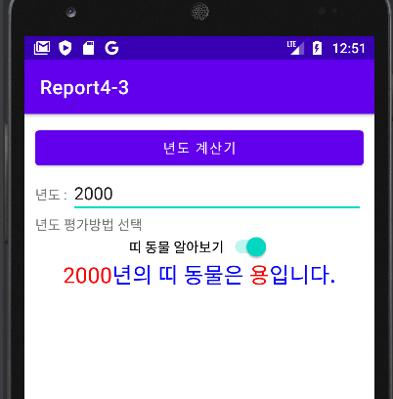
Report 3 홀수
package com.example.report4_3; import androidx.appcompat.app.AppCompatActivity; import android.graphics.Color; import android.graphics.Typeface; import android.os.Bundle; import android.text.Spannable; import android.text.SpannableString; import android.text.style.ForegroundColorSpan; import android.text.style.RelativeSizeSpan; import android.text.style.StyleSpan; import android.view.View; import android.widget.Button; import android.widget.EditText; import android.widget.Switch; import android.widget.TextView; import android.widget.Toast; public class MainActivity extends AppCompatActivity { @Override protected void onCreate(Bundle savedInstanceState) { super.onCreate(savedInstanceState); setContentView(R.layout.activity_main); Button button = findViewById(R.id.button1); EditText editText = findViewById(R.id.edit1); TextView textView = findViewById(R.id.text1); Switch sw1 = findViewById(R.id.sw1); button.setOnClickListener(new View.OnClickListener() { @Override public void onClick(View view) { String inputt1 = editText.getText().toString(); if (inputt1.equals("")){ Toast.makeText(getBaseContext(),"숫자를 입력해주세요.",Toast.LENGTH_SHORT).show(); } else { int input = Integer.parseInt(inputt1); if (input <1700){ Toast.makeText(getBaseContext(),"년도는 1700년 이상이여야 합니다.",Toast.LENGTH_SHORT).show(); } else if (sw1.isChecked() == false){ Toast.makeText(getBaseContext(),"띠 동물 알아보기 기능을 켜주세요.",Toast.LENGTH_SHORT).show(); } else{ switch (input%12){ //스위치 case 1: textView.setText(inputt1+"년의 띠 동물은 닭입니다."); break; case 2: textView.setText(inputt1+"년의 띠 동물은 개입니다."); break; case 3: textView.setText(inputt1+"년의 띠 동물은 돼지입니다."); break; case 4: textView.setText(inputt1+"년의 띠 동물은 쥐입니다."); break; case 5: textView.setText(inputt1+"년의 띠 동물은 소입니다."); break; case 6: textView.setText(inputt1+"년의 띠 동물은 범입니다."); break; case 7: textView.setText(inputt1+"년의 띠 동물은 토끼입니다."); break; case 8: textView.setText(inputt1+"년의 띠 동물은 용입니다."); break; case 9: textView.setText(inputt1+"년의 띠 동물은 뱀입니다."); break; case 10: textView.setText(inputt1+"년의 띠 동물은 말입니다."); break; case 11: textView.setText(inputt1+"년의 띠 동물은 양입니다."); break; case 12: textView.setText(inputt1+"년의 띠 동물은 원숭이입니다."); break; } String content = textView.getText().toString(); //일부 색깔넣는 코드 SpannableString spannableString = new SpannableString(content); int start1 = 0 , start2 = 13; int end1 = inputt1.length(),end2 = content.length()-4; spannableString.setSpan(new ForegroundColorSpan(Color.parseColor("#FF0000")), start1, end1, Spannable.SPAN_EXCLUSIVE_EXCLUSIVE); // 연도 색상 spannableString.setSpan(new ForegroundColorSpan(Color.parseColor("#FF0000")), start2, end2, Spannable.SPAN_EXCLUSIVE_EXCLUSIVE); // 띠 별 동물 색상 textView.setText(spannableString); } } } }); } }
<?xml version="1.0" encoding="utf-8"?> <LinearLayout xmlns:android="http://schemas.android.com/apk/res/android" xmlns:app="http://schemas.android.com/apk/res-auto" xmlns:tools="http://schemas.android.com/tools" android:layout_width="match_parent" android:layout_height="match_parent" android:orientation="vertical" android:padding="5pt" tools:context=".MainActivity"> <Button android:layout_width="match_parent" android:layout_height="wrap_content" android:id="@+id/button1" android:text="년도 계산기"/> <LinearLayout android:layout_width="match_parent" android:layout_height="wrap_content"> <TextView android:layout_width="wrap_content" android:layout_height="wrap_content" android:text="년도 : "/> <EditText android:id="@+id/edit1" android:layout_width="match_parent" android:layout_height="wrap_content" android:hint="년도를 입력해주세요."/> </LinearLayout> <TextView android:layout_width="wrap_content" android:layout_height="wrap_content" android:text="년도 평가방법 선택"/> <LinearLayout android:layout_width="match_parent" android:layout_height="wrap_content" android:gravity="center"> <Switch android:id="@+id/sw1" android:layout_width="wrap_content" android:layout_height="wrap_content" android:text="띠 동물 알아보기"/> </LinearLayout> <TextView android:id="@+id/text1" android:layout_width="match_parent" android:layout_height="wrap_content" android:textColor="#0000ff" android:textSize="10pt" android:gravity="center"/> </LinearLayout>
동물 이름을 string변수로 설정하면 매서드를 써도
코드가 너무 길어질 것 같아서 일단 start, end값 좌표로만 했습니다.

